Slide 1

Understanding Directed Acyclic Graph (DAG)
(in the context of Apache Spark)

Slide 2
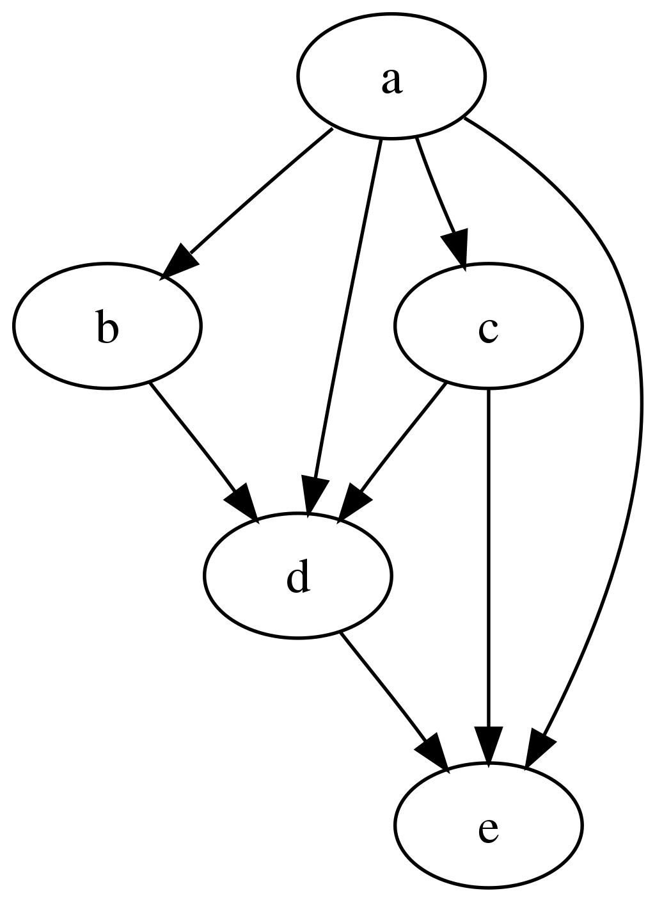
What is a DAG
Directed: Specific direction from one node to another (flow)
Acyclic: No sequences of edges that loop back to the same node (well-defined ordering among the nodes).
Nodes and Edges: A DAG consists of nodes (aka vertices) and directed edges.
Ordering: Some nodes must be processed or evaluated before others, as determined by the direction of the edges.
Source: en.wikipedia.org/wiki/Directed_acyclic_graph

Slide 3
Spark uses DAGs to Schedule steps
Spark driver receives an app to run
How much capacity is needed?
It then splits the job into tasks
Then, it schedules these on the executors
Each executor runs a task
.

Slide 4
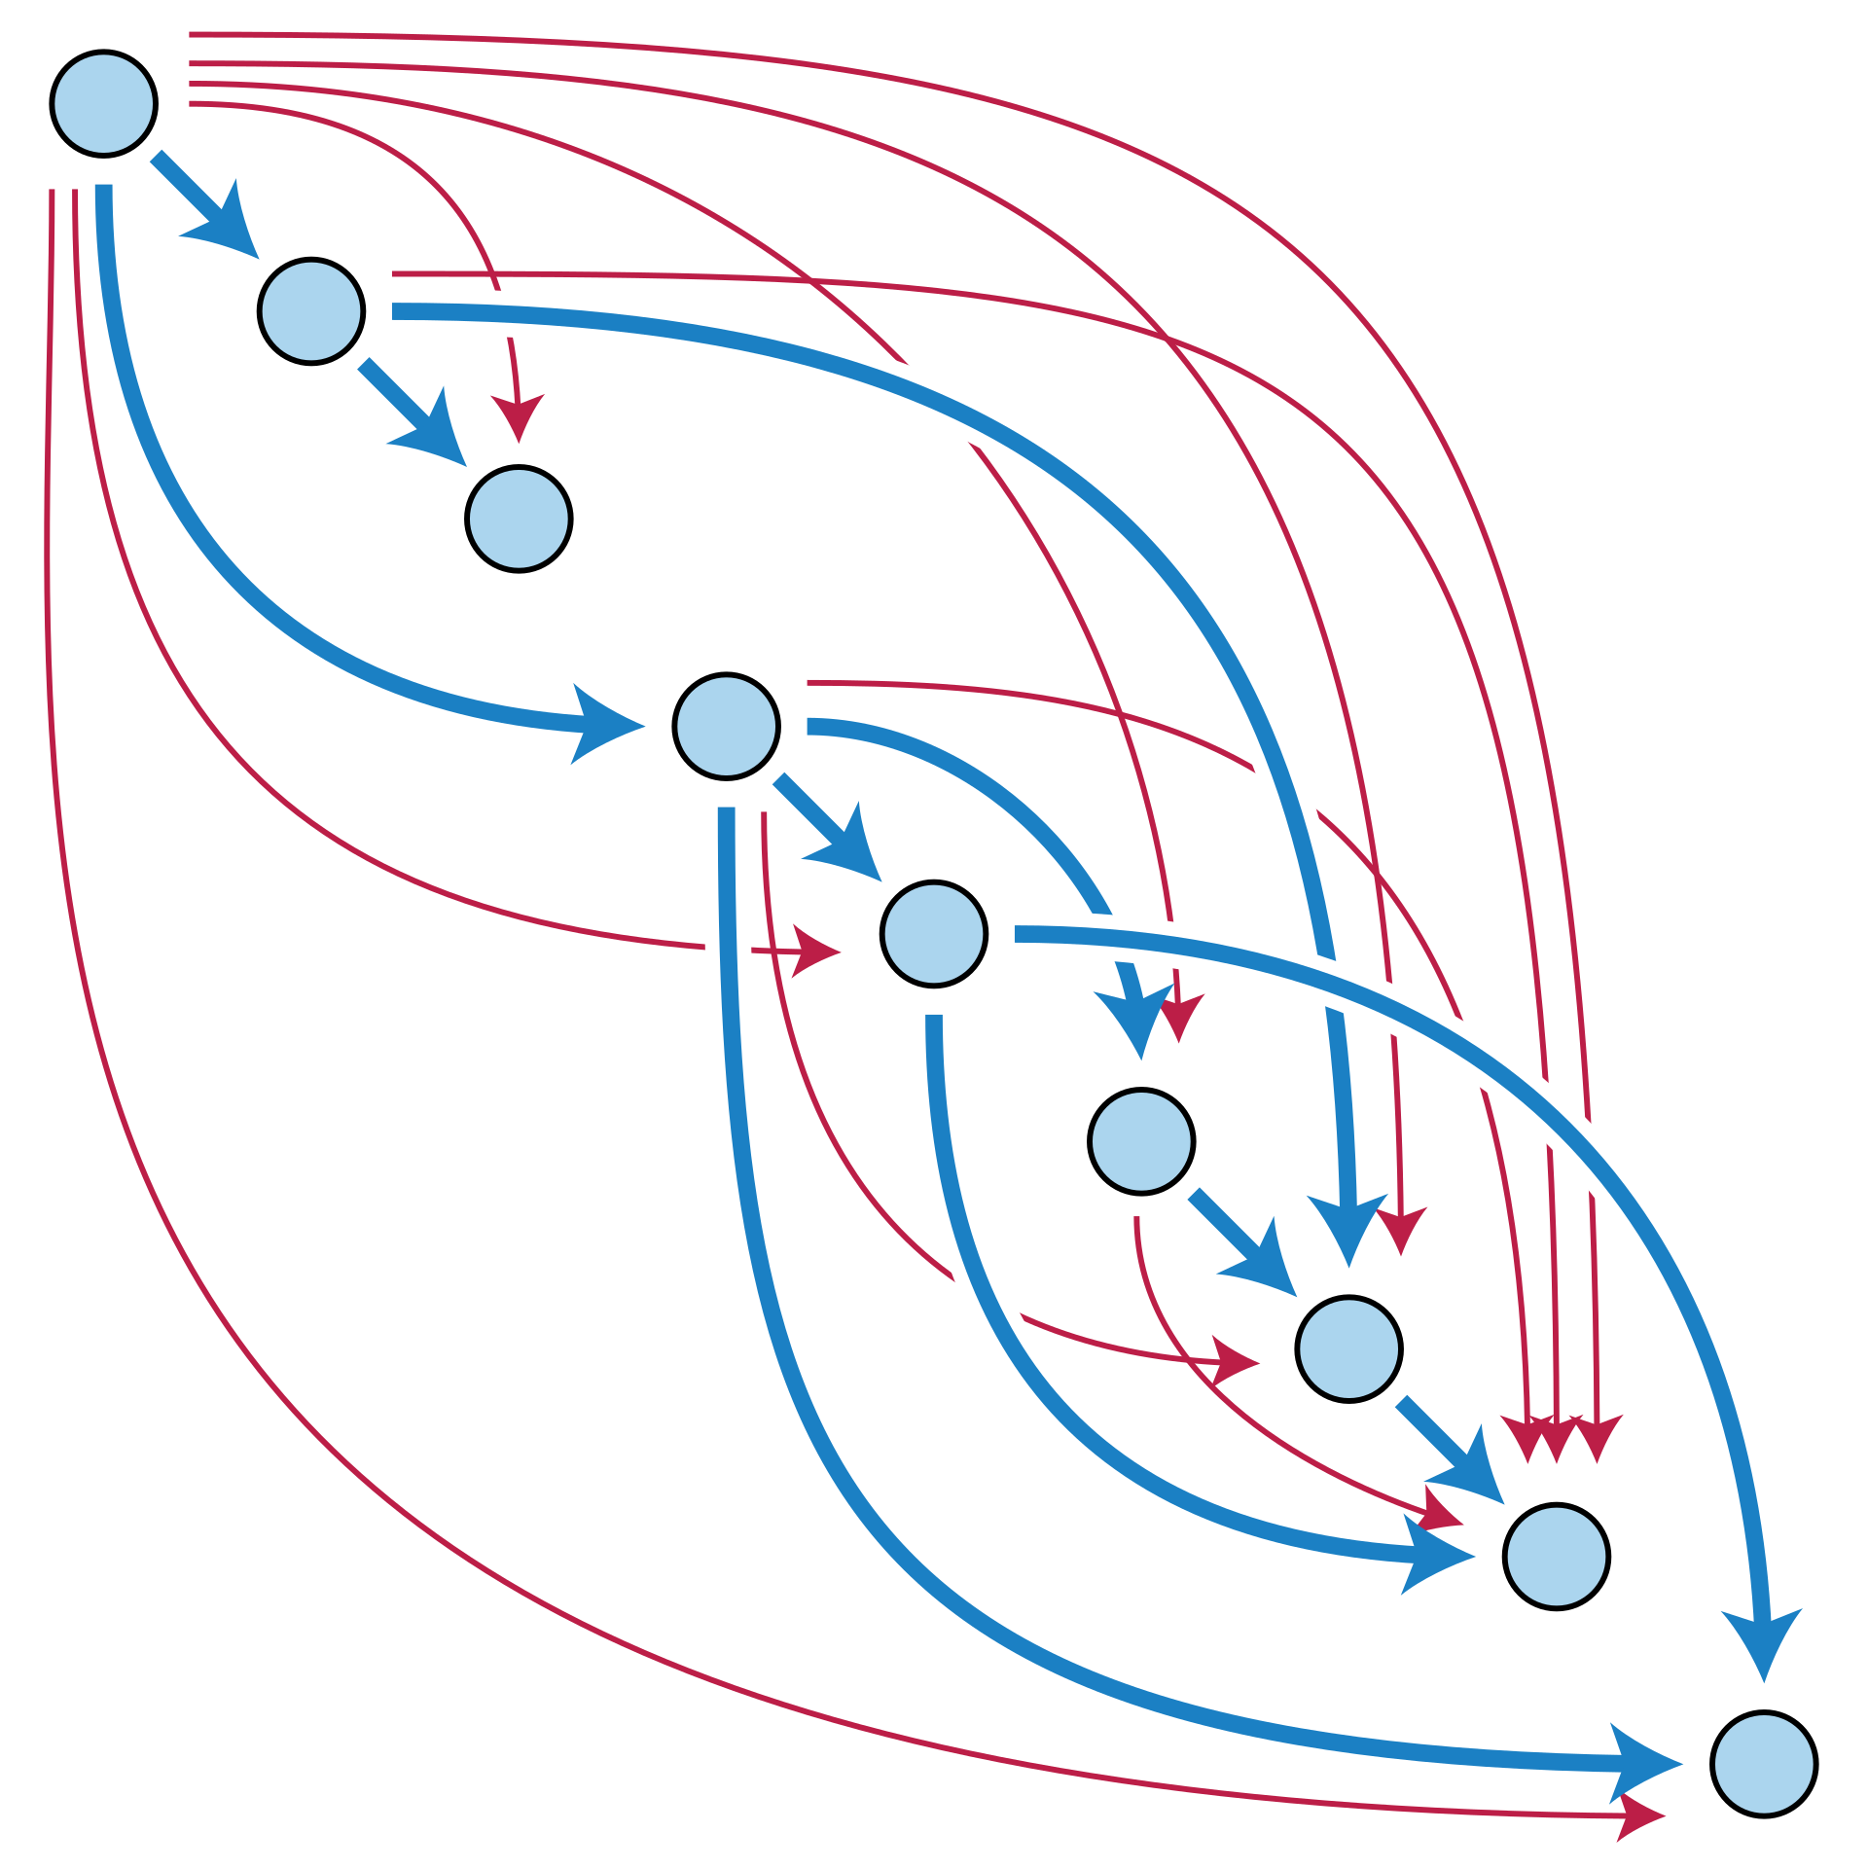
Spark Operations vs. DAG
Transformations: Operations applied to DFs or RDDs to create new DFs or RDDs.
Actions: Operations triggering the execution of transformations and producing results.
Spark Lazy evaluation
E -> T -> L

Slide 5

Spark Stages and Dependencies
Stages: Sets of transformations that can be executed together in PySpark.
Dependencies: Relationships defining the data flow and dependencies between RDDs.

Slide 6
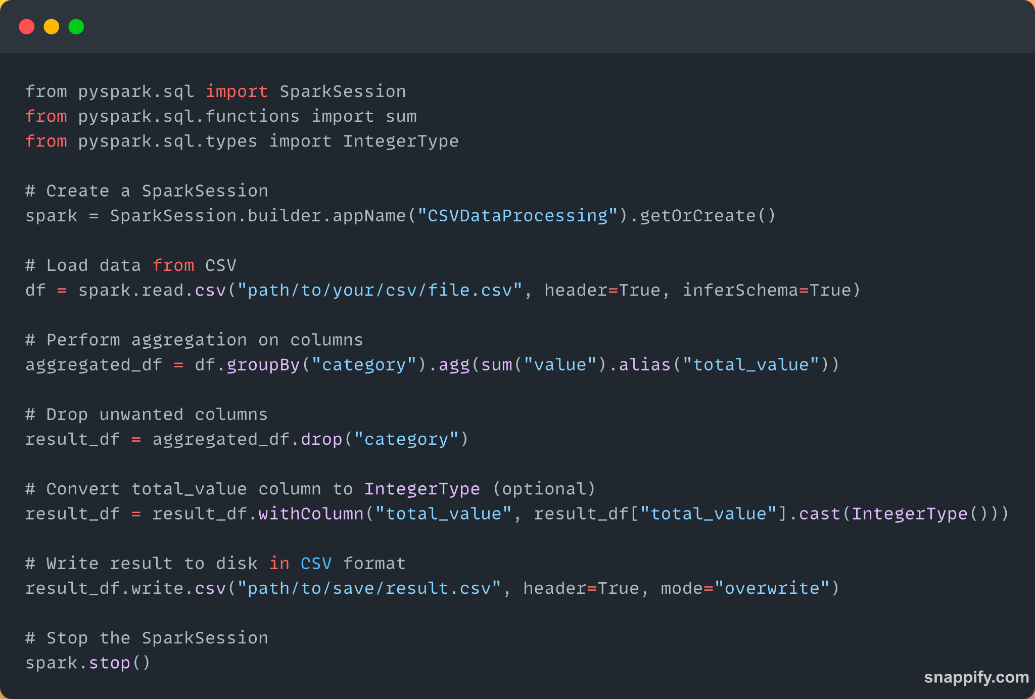
Example: DAG vs. Lazy evaluator

Slide 7

Next…

